Slide 1
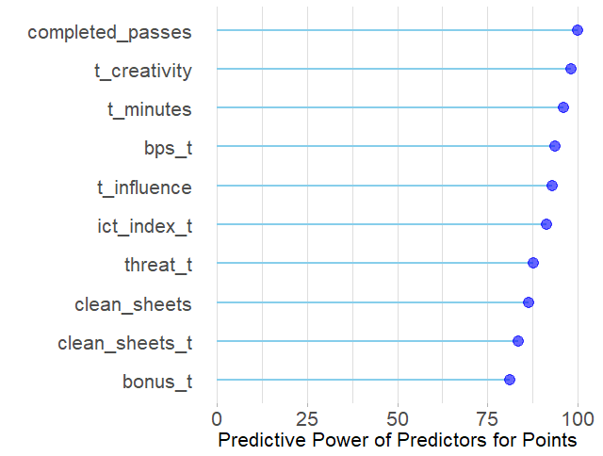
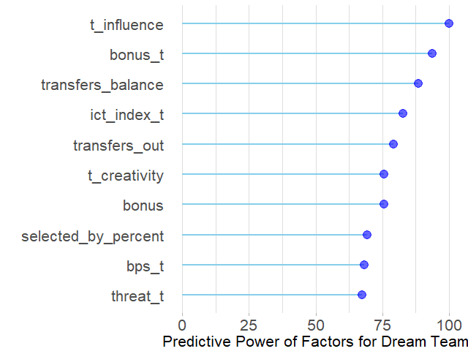
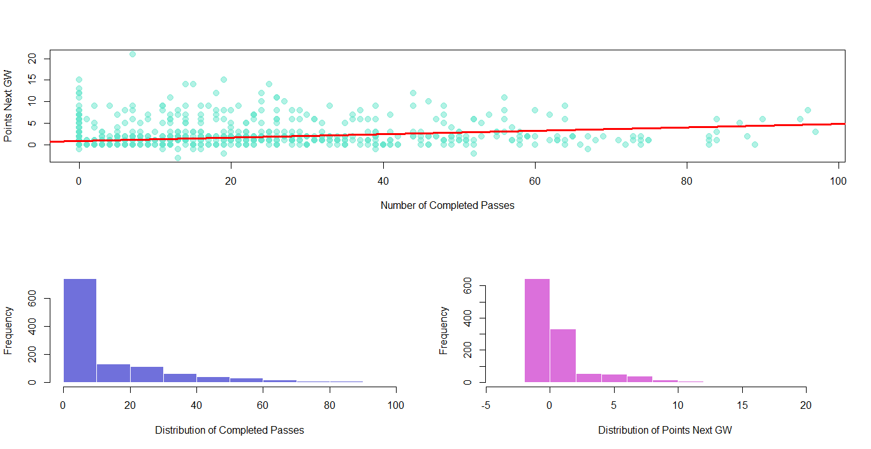
Does Past Help Predict Future In Fantasy Premier League? Duc Trinh And Shivam K C, The College of Wooster
Result
 | Points | Dream Team
Baseline | 6.01 | 0.0280
Random Forest | 4.70 | 0.0300
Regression | 4.79 | X
Abstract
Fantasy Premier League (FPL)—the biggest fantasy soccer game in the world with over five million players—is an online game where people assemble a team of real-life soccer players and score points based on the actual performance of these players. Since the points heavily depend on unpredictable factors like goals and assists, the points become harder to get. We used some of the few research (related to FPL) available to find factors that best predict points a player gets in FPL. After using several methods including random forest and regression, we have found the best predictors and may have gotten a glimpse of how to win FPL.
Table 1: Mean-squared error of various models.
Regression Model Predictors
Average Minutes played Average ICT Index ICT Index last game
Table 2: Significant factors in the best and the simplest regression model predicting Points.
Data
Figure 1: Graphs show top ten predictors that predict Points and Dream Team separately. The predictors are ranked in terms of their predictive power scaled out of 100.
Conclusion
FPL GW 15, 16, 28, 29, 33, and 34 Data
Raw Data: 2018/19 PL Season
1163 observations
64 factors
Dependent Variables
Player’s points in future GW
Player in Dream Team or not
Independent Variables
Completed passes in last GW
Average Creativity score
Average Minutes played and 59 others
Findings
Best factors for Points and Dream Team are attacking factors; also wisdom of the crowd for Dream Team
Random forest improves prediction Regression simplifies it
Limitations
Low sample size
Random forest causes multicolinearity
Future Work
Reference
Introduce more GW data
Definitely use predictive power of Random Forest for FPL
Requires more modeling like transformation
Anand, Vaastav. “Fantasy-Premier-League/data/2018-19/”.
Cummings, Nick. Mastering the Fantasy premier league: Transfer Hub guide to playing FPL. 2016.
Figure 2: Diagram shows correlation between Points and Completed Passes and their respective distributions.

